Slide 1
AmebaZ2 LZMA Flash Layout

Slide 2
Current Layout
LZMA Layout

Slide 3
LZMA Firmware
LZMA Firmware Content:
ROM validation header will be leading the concatenation as it is needed for ROM bootloader to validate the FW.
Followed by comp_file header which is consist of the compressed file status
Followed by each of the LZMA file accordingly
ROM validation header (320 bytes)
Comp_file header (2 + 2xN bytes)
LZMA File 1
(<16k bytes)
LZMA File 2 (<16k bytes)
LZMA File 3
(<16k bytes)
……
LZMA File N
(<16k bytes)
Properties (1 byte)
Dictionary Size (4 bytes)
Uncompressed Size (8 bytes)
LZMA Data ( <16k bytes)

Slide 4
LZMA Overall Workflow
Generated FW which will be compressed will have higher serial number than usual FW.
Compressed FW will be flashed to FW2 (0x104000) then decompressed at bootloader, then flash write into FW1 (0xC000)
IAR / GCC
Realtek PG Tool
FW Bootloader LZMA
Generated FW with SN+1
(firmware_is.bin)
firmware_is_lzma.bin flashed to FW2 address
Flash output to FW1
FW Bootloader Hal_flash
Python Script
FW Bootloader
FW Bootloader
Sliced, Compressed and Concatenated FW (firmware_is_lzma.bin)
Split firmware_is_lzma.bin and decompress using LZMA SDK from 7z
User FW selection run decompressed FW1

Slide 5
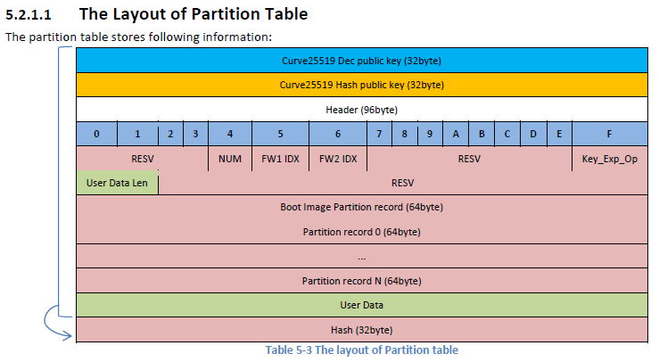
LZMA Enable Option
Bootloader will read partition table at 0x0020, offset 0xB2 for to determine whether to enable LZMA decompression.
Lzma_enable: 0x01 for Enable, with other values as Disabled
lzma_enable in 0x00D2 location

Slide 6
LZMA Firmware Boot Flow
FW2 LZMA Decompression
Perform 1st Decompression
Perform 2nd Decompression
Start
Bootloader FW Checks
Calculate offset address for read/write, perform decompression
Hash Comparison
No, but FW1 valid
Is hash OK?
No, and FW1 invalid
Is FW2 Serial Number > FW1?
No, FW1 valid and not erased
Is LZMA Header Valid?
Is FW1 valid?
Yes
No, but FW1 erased
Yes
No, but FW1 valid
No, and FW1 invalid
FW1 Write Region Size Precheck
Yes/No
LZMA Decode
Yes, 1st Decompression
Is FW2 valid?
Yes
Yes, 2nd Decompression
No, FW1 valid and not erased
No
Are all LZMA file Decompressed?
Yes, but FW1 valid
Is Decode OK?
Is Decompressed FW2 exceeded available space?
No, and FW1 invalid
No, but FW1 valid
No
No, but FW1 erased
Yes
Is this 2nd decompression?
Yes
Write decompressed Output to FW1
No
Erase FW1 according to decompressed FW size
No
FW Boot Decision
Bootloader reports error and Stop
Update Hash Value
Bootloader loads FW1

Slide 7
LZMA Algorithm Introduction
The Lempel–Ziv–Markov chain algorithm (LZMA) is an algorithm used to perform lossless data compression. This algorithm uses a dictionary compression scheme somewhat similar to the LZ77 algorithm.
LZMA uses a dictionary compression algorithm (a variant of LZ77 with huge dictionary sizes and special support for repeatedly used match distances), whose output is then encoded with a range encoder, using a complex model to make a probability prediction of each bit.
The dictionary compressor finds matches using sophisticated dictionary data structures, and produces a stream of literal symbols and phrase references, which is encoded one bit at a time by the range encoder: many encodings are possible, and a dynamic programming algorithm is used to select an optimal one under certain approximations
The main innovation of LZMA is that instead of a generic byte-based model, LZMA's model uses contexts specific to the bitfields in each representation of a literal or phrase: this is nearly as simple as a generic byte-based model but gives much better compression because it avoids mixing unrelated bits together in the same context.

Slide 8
LZMA Firmware Generation
All procedures here are done using Python v3.6
Hash Generation: A hash is generated from the data before compression then it is further checked once it is decompressed for the first time
Header Generation: ROM validation header and comp_file header are generated for firmware recognition by bootloader and to facilitate the decompression procedure.
Firmware Splitting: The firmware binary file (firmware_is.bin) is split into 16kbytes per binary files, except for the last file which is of the size of the remaining data.
LZMA Compression:
Each sliced binary file (firmware_split(x).bin) will be immediately compressed using lzma.exe from LZMA SDK, by the property of –d23, which is equivalent to dictionary size of 23 (2^23 = 8,388,608 bits).
Higher dictionary size yield faster processing time but at the same time, it would be more taxing on the memory usage.
Other properties of LZMA remained as default. Literal context bit, lc=3, literal position bits, lp=0, position bits, pb=2
Firmware Concatenation: Both header and compressed data are concatenated into a binary file to be flashed into FW2 address

Slide 9
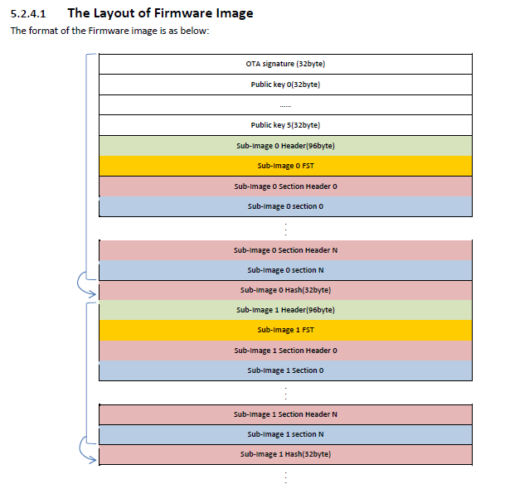
LZMA Firmware Hash Generation
Hash Generation:
A hash is generated in Python using Python hashlib SHA256
The Hash is appended at the end of the uncompressed FW, before the uncompressed FW is being split and compressed.
This Hash serves for the purpose of data verification during decompression.
…….
Hash Generated from Uncompressed FW

Slide 10
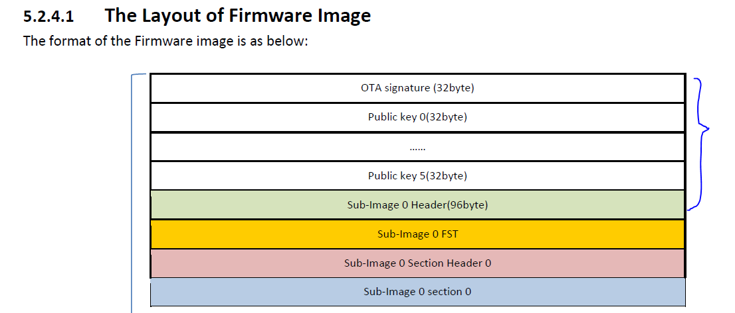
LZMA Firmware Header Generation
Header Generation (ROM validation Header):
This header is used by ROM bootloader to validate (firmware_is_lzma.bin) in FW2, the format is the same as usual FW header so that the bootloader can recognize the compressed FW.
This header is cropped from the first 320 bytes of the generated FW2 before it is being compressed. The first 320 bytes of the FW consist of fields that are needed to be verified by Bootloader, namely OTA Signature (32 byte) + 6 x Public Keys (6 x 32bytes) + Sub-Image 0 Header (96 bytes)
Screenshot below is an excerpt from AN0500 AmebaZ-II Application Note
320 bytes of header

Slide 11
LZMA Firmware Header Generation
Header Generation (Comp_file Header):
This header is used by the bootloader to distinguish the total number of received LZMA files, possibility of hash truncation, and file size of each compressed data.
First 2 bytes represents the numbers of total files
Next 2 bytes represent the start address of the Hash, if there is a possible truncated hash between last and second last file. If this field is 0, indicates that there is no hash truncation and the hash is perfectly appended on the last compressed LZMA file.
Finally, the trailing fields of 2 bytes each corresponds to the total size of sliced, compressed files. This file size is crucial for Ameba SDK to locate the start and end of each compressed file
Ideally these file size should be less than 16kbytes as they are compressed from 16kbytes.
The file size is depending on the repeatability of actual data. More repeated data yields much more compacted files.
Total LZMA Files (2 bytes)
Hash start location
LZMA File 1 File Size
(2 bytes)
LZMA File 2 File Size
(2 bytes)
LZMA File 3 File Size
(2 bytes)
…….
LZMA File
(N) File Size
(2 bytes)

Slide 12
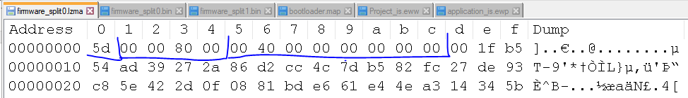
LZMA Compression
A compressed *.lzma file comes with a header and its trailing compressed data
In the header we have 1 byte of properties, 4 bytes of dictionary size and 8 bytes of uncompressed size
Below shows the calculation of properties. Please execute the formula sequentially in C in order to obtain lp and lc using known properties.
Note : we use lc=3, lp=0, pb=2 in this project
Properties = (pb * 5 + lp) * 9 + lc -> prop = (2 * 5 + 0) * 9 + 3 -> prop = 93 (0x5D)
pb = prop / ( 9 * 5) -> pb = 93 / 45 -> pb = 2
prop -= pb * 9 * 5; -> prop = prop – 2*9*5 -> prop = 3
lp = prop / 9; -> lp = 3 / 9 -> lp = 0
lc = prop – lp * 9; -> lc = 3 – 0 * 9 -> lc = 3
Below depicts the LZMA header of each LZMA file
Properties (1 byte)
Dictionary Size (4 bytes)
Uncompressed Size (8 bytes)
LZMA Data ( <16k bytes)

Slide 13
LZMA Decompression
All procedure in this chapter are performed in the bootloader
Bootloader user_boot_fw_selection function decides which FW to be loaded.
If FW1 is valid and serial number is later or equal to FW2, FW1 will be loaded
If FW1 is invalid while FW2 is valid, FW2 decompression will be started
If FW1 is valid but serial number is older than FW2 and FW2 is valid, FW2 decompression will be started
Otherwise, bootloader will report an error
In boot_lzma, bootLzma_main_task will proceed with the main decompression steps
First, the function gets the offset of read and write address.
Read address, read_addr is FW2 address offsetted by ROM bootloader validation size, which is consist of OTA Signature (32 byte) + 6 x Public Keys (6 * 32bytes) + Sub-Image 0 Header (96 bytes) then further offsett by Flash memory address base (0x98000000)
LZMA File read address, offset_lzmafile_read_addr, is read_addr offsetted again by comp_file header which is consist of total compressed file (2 bytes) + truncated hash start address (2 bytes) + total compressed file x LZMA file size (n * 2 bytes) in order to get to the start of 1st LZMA file.
Write address, in this case, is the start of FW1

Slide 14
LZMA Decompression (cont.)
Next, bootloader will perform the first decompression of FW2
Checks for the LZMA header format, byte 13th is always 0, properties size should be (pb * 5 + lp) * 9 + lc, where lc=3, lp=0, pb=2
Pass in the data to LZMA Decode from 7z SDK to perform decompression, the start address of data is offset due to LZMA header size is (5+8 bytes), Decompressed data will be available in output_buf.
Hash is updated each cycle based on the decompressed data of 16kb size.
Then, updated Hash is matched with the stored Hash from decompressed data to check for any discrepancy.
If the Hash is mismatched, bootloader will fall back to boot FW1 only if FW1 is valid, else, bootloader would report an error
Then, bootloader check for available region to flash between FW1 and FW2.
If decompressed size is larger than this region, error will be reported and fall back to boot FW1 if FW1 is valid
If precheck is OK, function proceeds to erase needed space in the manner of 4kb per cycle
Once first decompression complete and hash checking is OK, bootloader loops LZMA files one by one for second decompression
Repeats the same decompression steps in first decompression without updating and checking the hash
From output_buf, these decompressed data are flashed to FW1 using hal_flash_burst_write
After decompression and writing to FW1 is completed. Bootloader should continue to boot from FW1 for the newly decompressed firmware

Slide 15
LZMA Decompression Scope
Note: In current implementation, LZMA Decode capable of decoding different dictionary size *.lzma data, as long as the properties used are the same (0x5D).
This is because we are using static dictionary buffer for dictionary interface as bootloader does not support dynamic memory.

Slide 16
Current version vs. LZMA version
 | Current version | LZMA version
Boot time | ~100ms | ~2.6s + 6.1s
Support secure boot | Yes | Yes
Flash size | FW size * 2 | FW size + LZMA FW size(~60 – 70%) e.g. 286kb/443kb
Task | Time (s)
First Decompression | 0.875397
Memory Erasure | 6.129008
2nd Decompression and Write | 1.736571

Slide 17
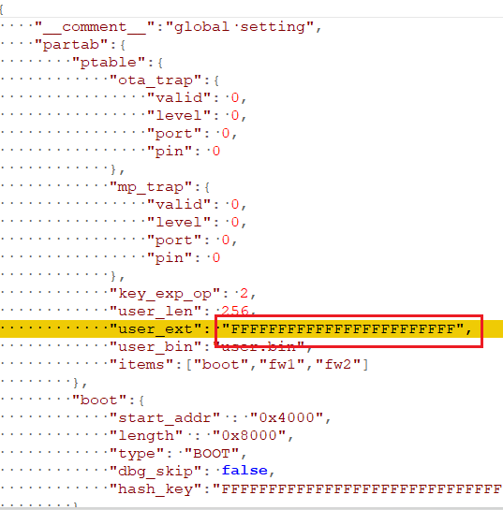
User Guide: IAR build
This chapter provide guides on generating a compressed FW copy -> firmware_is_lzma.bin
In sdk\project\realtek_amebaz2_v0_example\EWARM-RELEASE\partition.json, change user_ext": "FFFFFFFFFFFFFFFFFFFFFFFF” to “01FFFFFFFFFFFFFFFFFFFFFF”, as the first byte is used for enabling LZMA feature

Slide 18
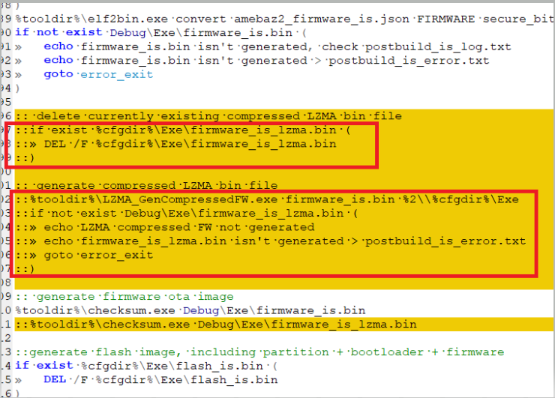
User Guide: IAR build
Replace content of sdk\project\realtek_amebaz2_v0_example\EWARM-RELEASE\bootloader.icf with bootloader_lzma.icf, this is to enlarge the flash memory to use
In sdk\component\soc\realtek\8710c\misc\iar_utility\postbuild_is.bat, uncomment these highlighted lines

Slide 19
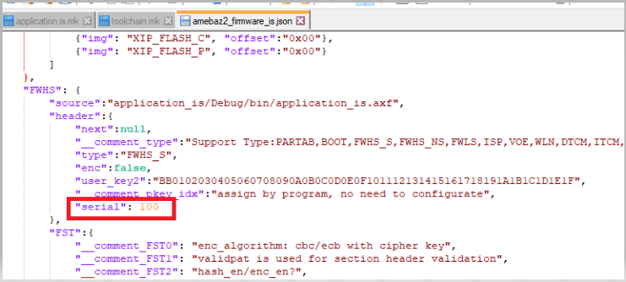
User Guide: IAR build
In sdk\project\realtek_amebaz2_v0_example\EWARM-RELEASE\ amebaz2_firmware_is.json, increase the serial number by 1, this is for the bootloader to recognize the newly build compressed FW as a new one.
Note: Assuming that user has already flashed a working FW at FW1 location with the serial number 100, user should ideally increase serial number for compressed FW to 101.

Slide 20
User Guide: IAR build
Make sure you have LZMA_GenCompressedFW.exe and lzma.exe in \component\soc\Realtek\8710c\misc\iar_utility, these files are meant for the compression steps. Users can run these standalone executable without having Python installed.
Build firmware as normal, user will be able to see generated compressed FW, firmware_is_lzma.bin in sdk\project\realtek_amebaz2_v0_example\GCC-RELEASE\application_is\Debug\bin
Note: Please flash FW1 with updated bootloader first (e.g. flash_is.bin with serial number 100) then only proceed to this step to generate new FW with latest serial number (e.g. 102)
If user has not been using bootloader with updated LZMA feature, then, copy this generated compressed file and try to generate current FW1 with updated bootloader and serial number 100; else, user can proceed to flashing firmware_is_lzma.bin
Refer to Flashing chapter to flash compressed FW

Slide 21
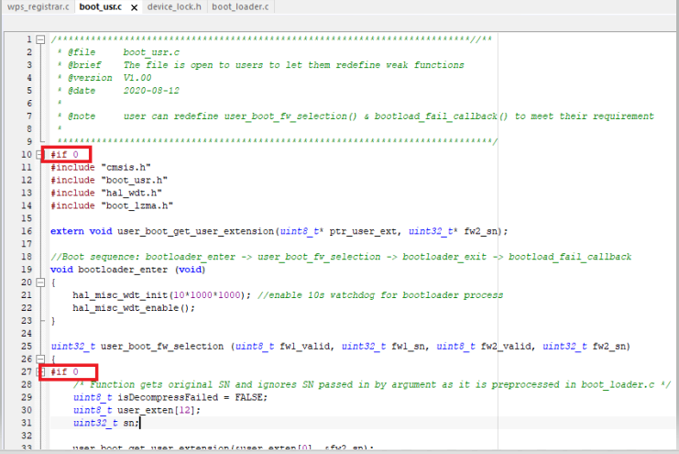
User Guide: GCC build
This chapter provide guides on generating a compressed FW copy -> firmware_is_lzma.bin using GCC
In sdk\project\realtek_amebaz2_v0_example\GCC-RELEASE\partition.json, change user_ext": "FFFFFFFFFFFFFFFFFFFFFFFF” to “01FFFFFFFFFFFFFFFFFFFFFF”, as the first byte is used for enabling LZMA feature
In AmebaSDK_Z2\sdk\component\soc\realtek\8710c\misc\platform\boot_usr.c, enable the first and second #if 0 to #if 1

Slide 22
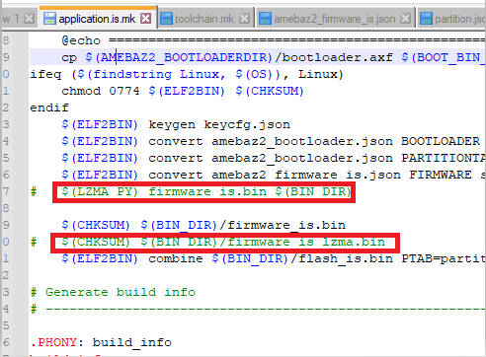
User Guide: GCC build
Replace sdk\project\realtek_amebaz2_v0_example\GCC-RELEASE\rtl8710c_img1.ld with rtl8710c_img1_lzma.ld, this is to enlarge the flash memory to use, then
In sdk\project\realtek_amebaz2_v0_example\GCC-RELEASE\application.is.mk, uncomment these lines

Slide 23
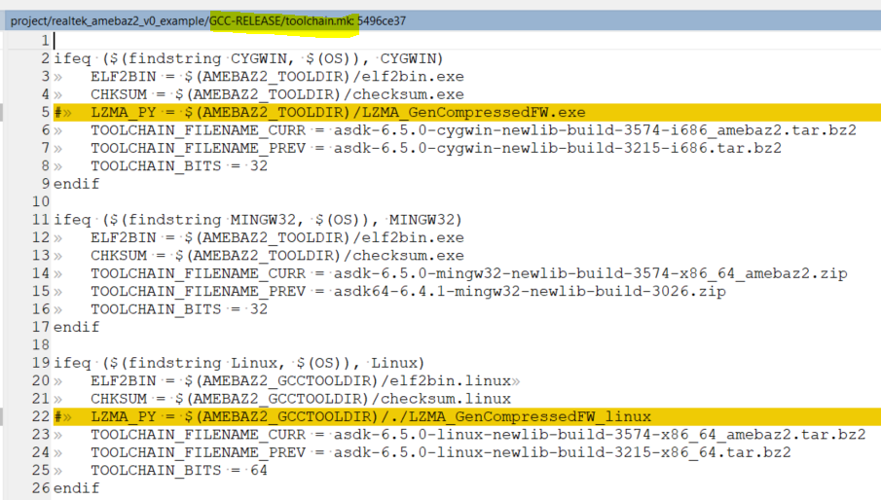
User Guide: GCC build
Uncomment toolchain.mk to enable python generated exe to do compression

Slide 24
User Guide: GCC build
Note: Assuming that user has already flashed a working FW at FW1 location with the serial number 100, user should ideally increase serial number for compressed FW to 101.
Note: Please flash FW1 with updated bootloader first (e.g. flash_is.bin with serial number 100) then only proceed to this step to generate new FW with latest serial number (e.g. 102)
In sdk\project\realtek_amebaz2_v0_example\GCC-RELEASE\ amebaz2_firmware_is.json, increase the serial number by 1, this is for the bootloader to recognize the newly build compressed FW as a new one.

Slide 25
User Guide: GCC build
Make sure you have LZMA_GenCompressedFW.exe and lzma.exe in \component\soc\Realtek\8710c\misc\iar_utility, these files are meant for the compression steps. Users can run these standalone executable without having Python installed.
Build firmware as normal, user will be able to see generated compressed FW, firmware_is_lzma.bin in sdk\project\realtek_amebaz2_v0_example\GCC-RELEASE\application_is\Debug\bin
If user has not been using bootloader with updated LZMA feature, then, copy this generated compressed file and try to generate current FW1 with updated bootloader and serial number 100; else, user can proceed to flashing firmware_is_lzma.bin

Slide 26
User Guide: GCC build in Linux
This chapter provide guides on generating a compressed FW copy -> firmware_is_lzma.bin using GCC in Linux enviroment
In sdk\project\realtek_amebaz2_v0_example\GCC-RELEASE\partition.json, change user_ext": "FFFFFFFFFFFFFFFFFFFFFFFF” to “01FFFFFFFFFFFFFFFFFFFFFF”, as the first byte is used for enabling LZMA feature

Slide 27
User Guide: GCC build
User Guide: GCC build in Linux
Replace sdk\project\realtek_amebaz2_v0_example\GCC-RELEASE\rtl8710c_img1.ld with rtl8710c_img1_lzma.ld, this is to enlarge the flash memory to use, then
In sdk\project\realtek_amebaz2_v0_example\GCC-RELEASE\application.is.mk, uncomment these lines

Slide 28
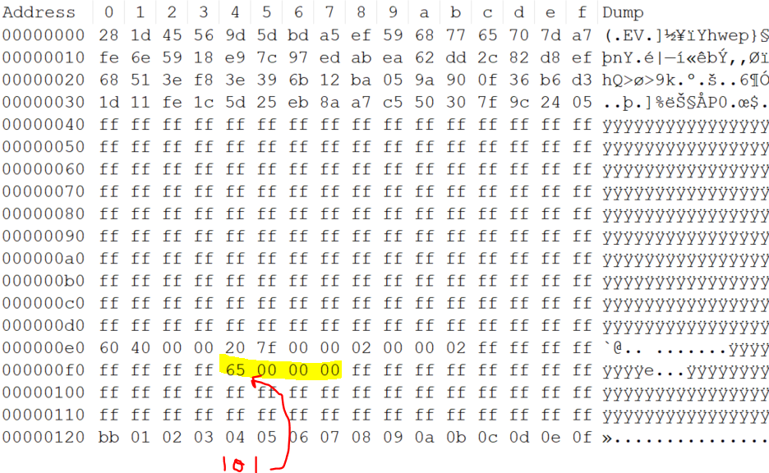
User Guide: GCC build
User Guide: GCC build in Linux
In sdk\project\realtek_amebaz2_v0_example\GCC-RELEASE\ amebaz2_firmware_is.json, increase the serial number by 1, this is for the bootloader to recognize the newly build compressed FW as a new one.
Note: Assuming that user has already flashed a working FW at FW1 location with the serial number 100, user should ideally increase serial number for compressed FW to 101.
The built FW should have 101 Serial Number (0x65)

Slide 29
User Guide: GCC build
User Guide: GCC build in Linux
Make sure you have LZMA_GenCompressedFW_linux and lzma_linux in \component\soc\Realtek\8710c\misc\gcc_utility, these files are meant for the compression steps. Users can run these standalone executable without having Python installed.
Build firmware as normal, user will be able to see generated compressed FW, firmware_is_lzma.bin in sdk\project\realtek_amebaz2_v0_example\GCC-RELEASE\application_is\Debug\bin
If user has not been using bootloader with updated LZMA feature, then, copy this generated compressed file and try to generate current FW1 with updated bootloader and serial number 100; else, user can proceed to flashing firmware_is_lzma.bin

Slide 30
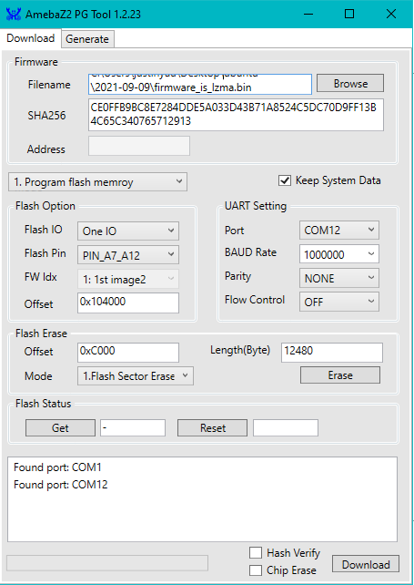
User Guide: Flashing
The compressed FW, firmware_is_lzma.bin should be flashed to offset of 0x104000, which is the start of FW2 address
Bootloader will attempt to decompress FW2 and further flash it to FW1 upon reboot
Please untick chip erase as we don’t want to erase FW1 during the flashing of compressed FW to FW2 position

Slide 31
User Guide: Result
After compressed FW is flashed on FW2 location, reset the board and it would take around 6~8 secs to decompress
A message will show if decompression success

Slide 32
Thank You

